Slide 1
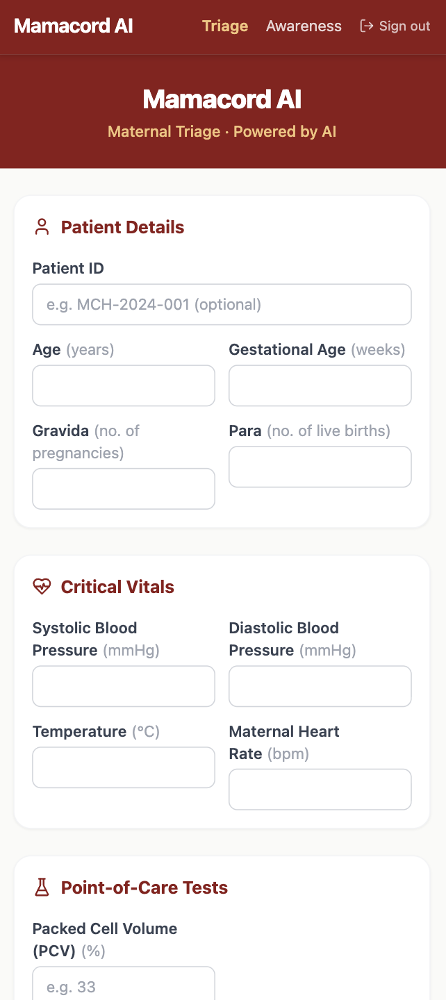

MAMALINK TEAM
AI-powered maternal triage for frontline health workers
in low-resource settings
· Primary Health Centres · TBAs · CHWs
PROJECT BY:
Mamalink Team

Slide 2


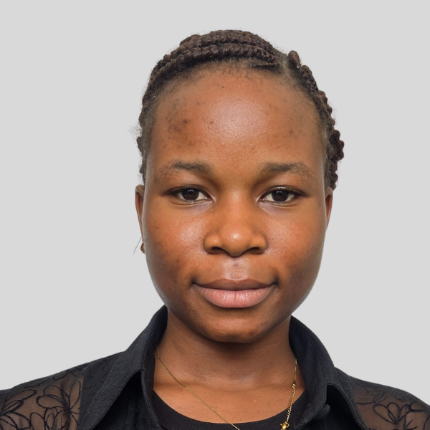

TEAM & CLOSE
DR. UTHMAN BABATUNDE
OLAMIDE OSO
FADEKEMI FADARE
EZEKIEL OLADEJO
Public Health Professional
Product & UXer
Medical Doctor / AI Researcher
AI Engineer
Medicine
Obstetric expertise
RAG pipeline
LLM integration
Nigeria health
systems
Low-resource
interface
We are not just building the future of maternal healthcare.
We are saving the women for it.
MAMACORD AI · MAMALINK 2026

Slide 3

THE PROBLEM
"She felt fine. She never made it to the hospital."
Amina. 28 years old. 34 weeks pregnant. BP 158/106. Protein in her urine. Her traditional birth attendant had no tool to recognise the danger. Amina went home. She didn't survive the night.
1,047
30%
Every 7 min
Maternal deaths per 100,000
live births in Nigeria (WHO)
of ALL global maternal deaths
occur in Nigeria alone
A woman dies in childbirth
in Nigeria
Globally, a maternal death occurs every 2 minutes. Over 90% happen in low-income countries. Sub-Saharan Africa carries 70% of the global burden. Nigeria is ground zero.
MAMACORD AI · MAMALINK 2026

Slide 4
THE GAP
The referral chain is broken at every link
No objective triage
No structured handover
No digital record
TBAs and CHWs rely on intuition. No standardised risk assessment tool exists for their context. A dangerous BP reading goes unrecognised.
No clinical summary travels with the patient on referral. The specialist at the receiving facility starts from zero, losing critical minutes.
No EHRs in low-resource PHCs. Data lives on paper only — and disappears at every care transition. Patterns cannot be tracked or learned from.
Specialist-designed apps exist — but they are built for hospitals, not for a TBA with a smartphone in a rural compound.
MAMACORD AI · MAMALINK 2026

Slide 5

AI triage specifically targeting the Big Three killers of pregnancy — pre-eclampsia, haemorrhage, and sepsis — on any smartphone, at the point of care.
GREEN
YELLOW
RED
Routine monitoring.
No immediate action required.
Elevated risk. Increase monitoring frequency.
Review at next visit.
High risk. Immediate referral.
Handover note auto-generated.
MAMACORD AI · MAMALINK 2026

Slide 6
Technical Architecture
How Mamacord AI delivers WHO-grounded clinical reasoning
HYBRID RAG ENGINE
SAFETY OVERRIDES
TRIAGE OUTPUT
Semantic Search + BM25 Re-ranking
GPT-4o-mini with strict JSON output
1,200+ chunks from WHO Maternal Health Guidelines
Citation-linked reasoning — every flag traced to a WHO section
Hard-coded Python thresholds
BP ≥ 160/110 → forced RED
Temp > 38°C → forced RED
PCV < 21% → forced RED
Proteinuria ≥ 1+ → forced RED
Cannot be hallucinated away
GREEN / YELLOW / RED
in under 2 minutes
RED → Auto-generated handover note
Vitals + Risk flags + WHO citations
Sent ahead so the specialist is ready
Vitals Input
→
RAG + BM25
→
Safety Check
→
Triage Result
MAMACORD AI · MAMALINK 2026

Slide 7
HOW IT WORKS - Demo
From vitals to referral — in under 2 minutes
INPUT
RAG ENGINE
RISK FLAG
IF RED →
BP · Temp · HR
Urine protein · Hb
USS findings
→
GPT-4o-mini
+
vector DB
→
Green / Yellow /
Red output
+ citation
→
Auto-generate
handover note
+ referral
MAMACORD AI REFERRAL SUMMARY HIGH RISK ● Patient: Amina O. · Age: 28 · GA: 34 weeks BP: 158/106 mmHg · Temp: 37.1°C · Urine protein: 2+ · Hb: 9.2 g/dL · FHR: 148 bpm ⚠ Pre-eclampsia confirmed — immediate specialist review required Grounded in: Nigerian National Maternal Health Guidelines
MAMACORD AI · MAMALINK 2026

Slide 8
BUSINESS MODEL & ROADMAP
Sustainable by design
Revenue Model
Roadmap
B2G License to state ministries of health and NGOs — per-PHC or per-CHW deployed.
Phase 1 (Now) Hackathon prototype — RAG triage engine with web UI.
B2B Subscription for private hospital networks seeking community feeder data.
Phase 2 Pilot with 20 PHC nurses in Oyo State. Obstetrician validation of 100+ triage decisions.
Grants WHO, Gates Foundation, USAID maternal health programmes.
Phase 3 State-level deployment. Integration with NHMIS reporting system.
No new infrastructure required. Works on existing Android smartphones. Deployable on day one.
MAMACORD AI · MAMALINK 2026

Slide 9


